Slide 1

Supplementary Live Session Week 2
MET CS 682
Information Systems
Analysis and Design
Dawson Williams
1/18/23

Slide 2
Agenda
Development Process:
Waterfall
Rapid Application Development (RAD)
Agile (Scrum, Kanaban, XP, SAFe)
Tradeoffs & Selection of a Suitable Process.
Process Review
Risk Management
Project Management (will be covered in more detail week 6 live class)
Scope, WBS
Organize & manage your Team
Use tools to manage Project

Slide 3
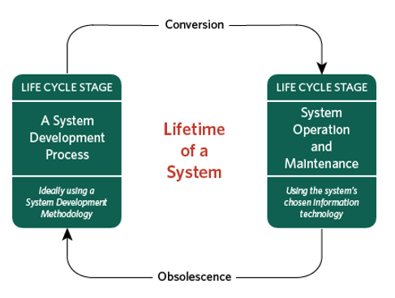
Systems Development Process
Initiation/Planning
Identifying problem & opportunity, outlining project
Requirements Analysis
Specification of application
Design
Specification, Design of parts
Implementation
Coding, Installation, Integration
Testing
Does it do what it’s supposed to
Maintenance
Defect repair, minor modifications/extensions

Slide 4
Project Identification
Business need: responding to emerging technology and market trends, to decrease cost or to increase profit.
Support business operations.
Improve process efficiency and adding additional features for usability.
Improve system performance or update technology of existing systems.
Introduce additional control and security to comply with business and government regulations.

Slide 5
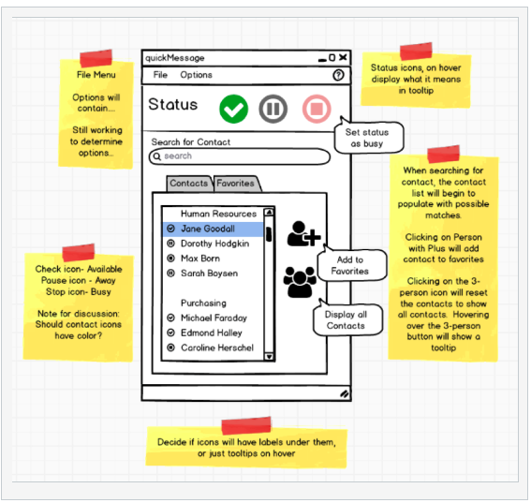
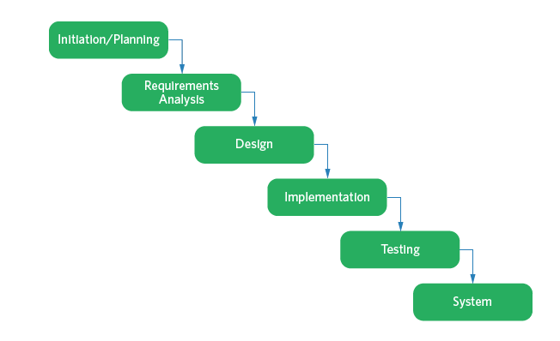
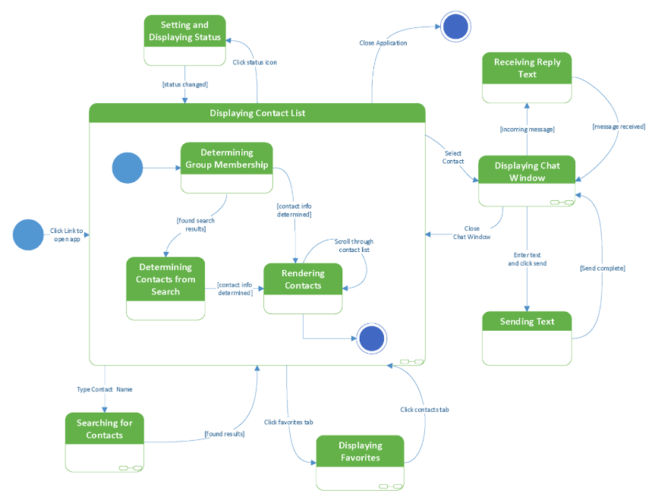
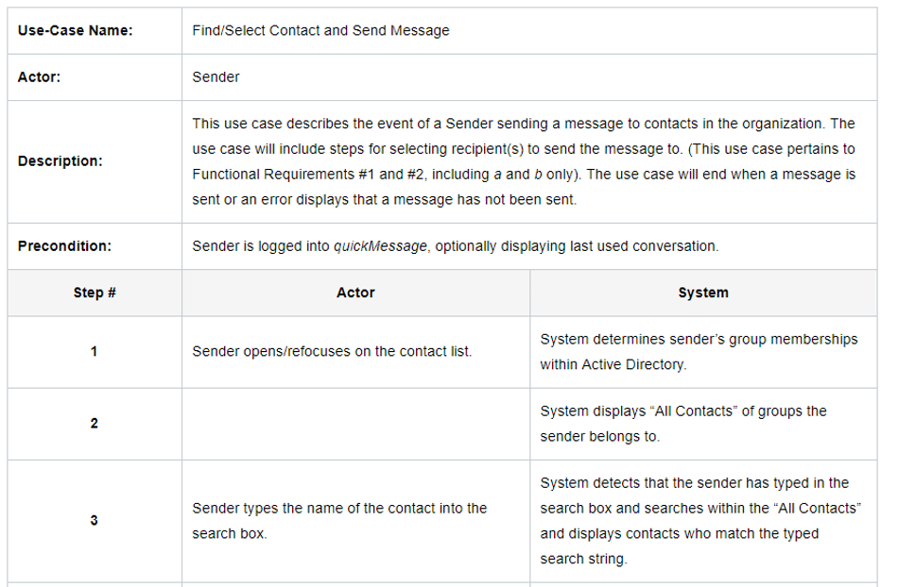
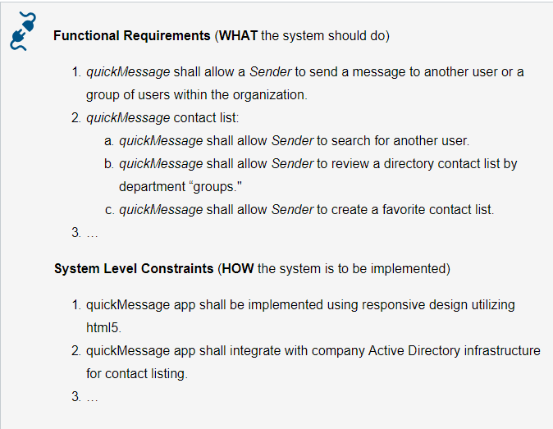
Waterfall
Perform phases in a structured step-by-step single sequence.
Completes each phase one after another (or minor overlap) and only once (Whitten, 2007)
Notes:
Best suited to stable requirements and systems whose scope is well understood
Requirements defined up-front before programming begins.
Minimize changes in scope of requirements.
Easier to understand, and relatively easy to manage.
Original planning covers the entire project.
Produces Extensive Documentation.
Well geared to offshore and or new developers who have to follow specific documentation.
Specific set deadlines
Easier to estimate effort based on past experiences of similar systems.
Drawbacks
You don’t really know up front everything that is wanted and needed
Hard to imagine every detail in advance.
If project misses important requirements, the system will not provide the value it was originally envisioned to provide.
Customers often understand what they really want only when they see the system in operation.
Stakeholders don’t want to wait a long time to use the system
Value may no longer be there.
Motivation
Experienced programmers may not have any input on the direction of the product.

Slide 6
Key Advantages of Waterfall
Best suited to stable requirements and systems whose scope is well understood
Requirements defined up-front before programming begins.
Minimize changes in scope of requirements.
Easier to understand, and relatively easy to manage.
Original planning covers the entire project.
Produces Extensive Documentation.
Well geared to offshore and or unskilled labor who have to follow specific documentation.
Specific set deadlines
Easier to estimate effort based on past experiences of similar systems.

Slide 7
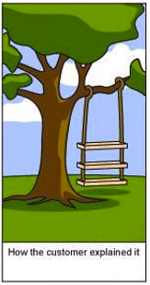
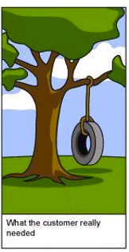
Challenges of Gathering Requirements
Customers are seldom sure of what they want
Customers provide incomplete or conflicting requirements
How do we know when we have achieved “sufficient” requirements?
no intermediate versions
Notes:
You don't know up front everything that is wanted and needed
Hard to imagine every detail in advance, especially if no experience in building exactly this type of the system.
If project misses important requirements, the system will not provide the value it was originally envisioned to provide.
You need to demonstrate intermediate versions
Reassurance that project is progressing in the right direction.
Customers often understand what they really want only when they see the system in operation. Only then will they formulate their needs clearly.

Slide 8
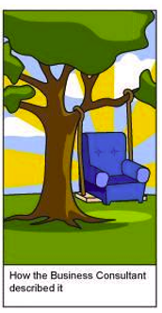
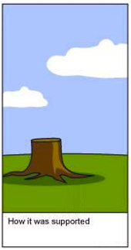
Challenges of Delivering Requirements
Process takes too long to deliver a product to realize it’s value
Hard to estimate up front the magnitude of the effort required
Motivation:
It is not easy to maintain constructive interpersonal team dynamics with differing opinions and priorities.
Experienced developers not having input
Notes:
Stakeholders don’t want to wait a long time to use the system
Value may no longer be there
It is hard to estimate reliably time and resources needed
To gain confidence in an estimate, you need experience in doing a design and implementing parts, especially the riskiest ones, for a similar system.
Team members should not be idle
Put people to work on more than one phase at once.
What do programmers and testers do while analysts are nailing down requirements? What do analysts do while the programmers are coding?
Motivation
Experienced programmers may not have any input on the direction of the product.

Slide 9
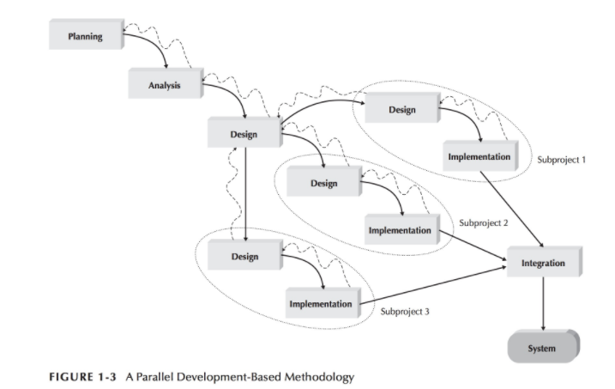
Parallel Waterfall Methodology
Distinct Subprojects which are designed and implemented in parallel – integrated at the end. (Dennis, A., Wixom, B. H., Tegarden, D. 2015)

Slide 10
Shifting software paradigm
Applications being delivered through internet over client systems installed on individual computers or devices.
Shift from supporting enterprise business process to tools supporting and augmenting everyday life.
Computing Eras
1970s - mainframe computing
1980s/1990s personal computing
1990s/2000s Internet and mobile computing
2010s - Internet of Things – smart devices
2020s Augmented/Virtual Reality, Artificial Intelligence

Slide 11
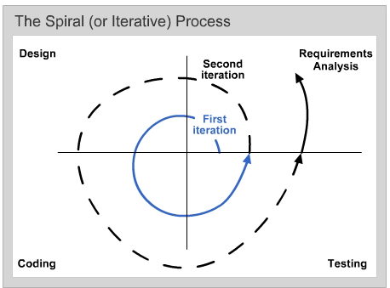
Rapid Application Development Process
Iterates through the entire waterfall several times.
Known as RAD, Iterative, Spiral, parallel or Incremental.
Barry Boehm - Spiral (1988)
Rapid Application Development 1990s

Slide 12
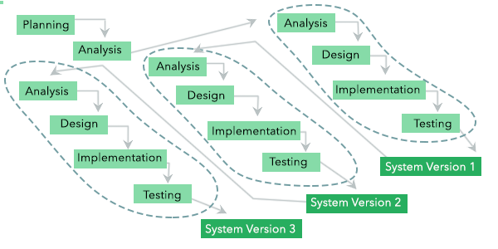
Phased Development
Series of versions developed sequentially.
Pros
V1 - focus on most important features.
Get most important features to users quickly (v1).
Users identify additional requirements.
Cons
Early versions are incomplete systems
(Dennis, A., Wixom, B. H., Tegarden, D. 2015)

Slide 13
Prototyping
Prototyping: Each iteration produces an intermediate product (version/prototype) that is more capable than the previous product.
Customer feedback is used to produce new requirements
Create a new or modified design and implement a new version of the product before the next iteration.
The last iteration produces the final product.

Slide 14
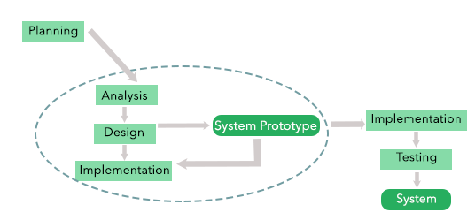
Prototyping Development
Pros
V1 - focus on most important features.
Get features to users quickly to review.
Users identify and refine additional requirements.
Users “try” system being built
Cons
Early versions are poor/lacking, fundamental underlying issues with design.
Knowing when you are done.
(Dennis, A., Wixom, B. H., Tegarden, D. 2015)

Slide 15
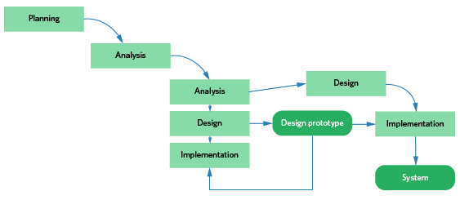
Spiral- Throwaway Prototyping
Pros
V1 - focus on most important features.
Get features to users quickly to review.
Users identify and refine additional requirements.
Design prototypes (mock-ups – Wireframes or small parts of system)
Users “see, try” system being built.
Improves Analysis
Cons
Early versions are poor/lacking, fundamental underlying issues with design.
Takes longer than regular prototyping.
Knowing when you are done.
(Dennis, A., Wixom, B. H., Tegarden, D. 2015)

Slide 16
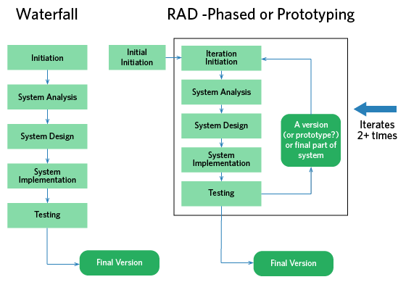
SDLC Methodologies

Slide 17
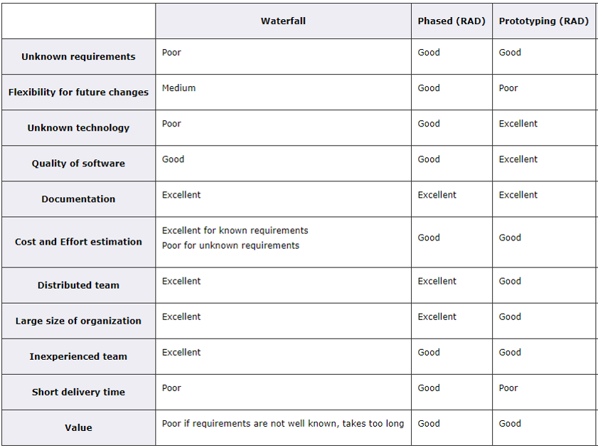
System Development Process Tradeoffs

Slide 18
Agile Process
Uncovering better ways of developing software by doing it and helping others do it.
Agile Manifesto (https://agilemanifesto.org/)
Individuals and interactions over processes and tools
Working software over comprehensive documentation
Customer collaboration over contract negotiation
Responding to change over following a plan

Slide 19
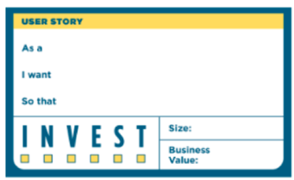
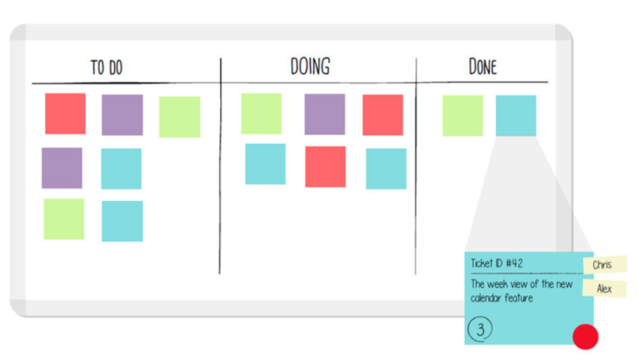
Agile Process Characteristics
Iterative Sprints: Quick cycling through development stages
Flexibility & Speed:
Early and continuous delivery, changing requirements.
Code-centered Documentation
Short Cycles (2-4 week sprint in Scrum)
Refactoring: making (constant) small changes
Communication & Collaboration:
Requirements through User stories
Developers & Business People working together daily.
Face-to-Face preferred
Pair Programming

Slide 20
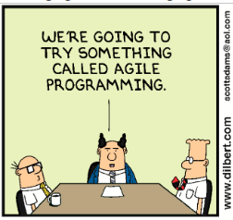
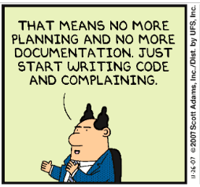
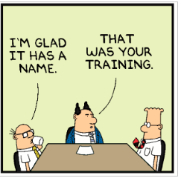
Agile Process Characteristics
Simplicity: focus Current Priority Needs vs. Future Extensions
Feedback: including customers in the process, Prototyping
Motivated Teams: Self-Organizing peer teams, Trust
Technical Excellence: focus on Good Design, Quality
Courage: ability to start fresh, throw away code/designs which don’t fit.

Slide 21
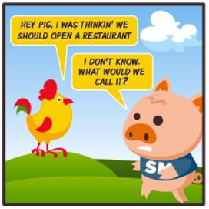
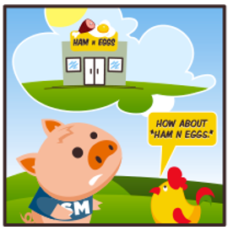
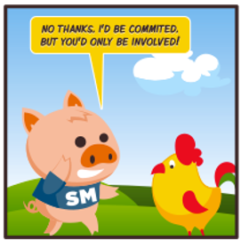
Agile Process Concerns
Who is committed? Who is involved?
Agile processes places planning & documentation into lower priority, but it does not mean you should not document.
How do we make sure to not forget documentation?
Keeping scope, budget & deadlines
When do we know we are done?
Agile in large vs. small projects?
Staff Experience
What happens when original team leaves?
What if you have distributed teams?
How to keep an eye on the big picture?
https://www.braintrustgroup.com/scrum-the-chicken-and-pig-story/

Slide 22
Agile Practices and Methods
Extreme Programming (XP)
Kanban
Scrum
Scaled Agile Framework (SAFe)
DevOps (Combine Dev with IT)

Slide 23
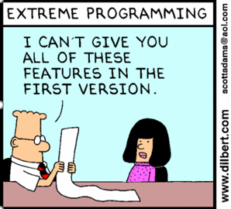
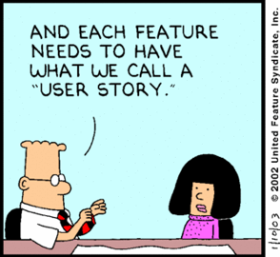
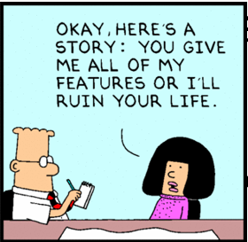
Extreme Programming (XP)
Core Values
Communication
Simplicity – KISS (keep it simple)
Feedback
Courage
Continues Incremental Changes
Except and embrace change
Quality first mentality (develop skills)
Continues testing
Paired Programming
Close Interactions with end-users
(Dennis, A., Wixom, B. H., Tegarden, D. 2015)

Slide 24
Scrum Framework
A framework within which people can address complex adaptive problems, while productively and creatively delivering products of the highest possible value. (Schwaber & Sutherland, 2013)
Not a process or a technique for building products
Framework within which you can employ various processes and techniques.
Used since early 1990s.
Scrum employs an iterative, incremental approach to optimize predictability and control risk.
Transparency: common language, definitions
Inspection: frequent, detect undesirable variances
Balance real work vs. inspection
Adoption: Quick adjustments, discard components not needed
(Schwaber & Sutherland, 2013)

Slide 25
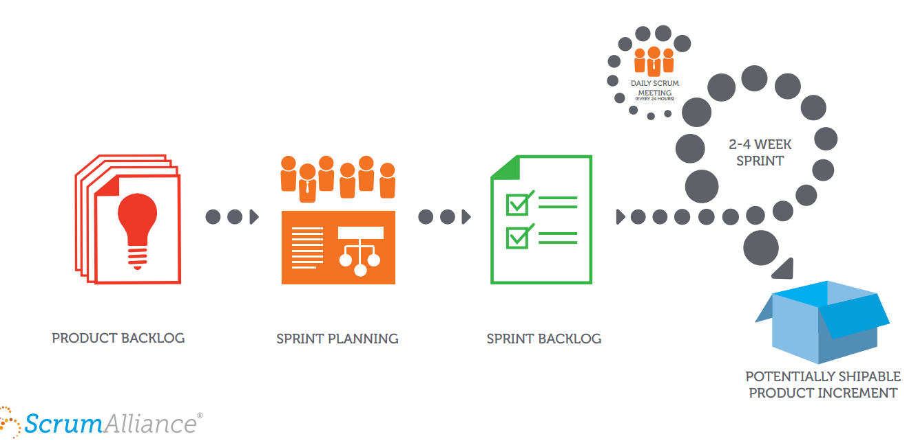
Scrum Framework
“Done” Incremental deliveries of “Done” product satisfy product backlog and ensure a potentially useful version of working product is always available.
(Scrum Alliance, Scrum Explained)
Notes:
Sprint: a Time-box of one month or less during which a “Done”, useable, and potentially releasable product Increment is created, followed by another Sprint, it can be cancelled.
Reasoning: if >30 days, the definition of what is being built may change, complexity may rise, and risk may increase.
Sprint Planning (8 hours): What is to be delivered and how (Sprint Goal).
Sprint Goal is an objective set for the Sprint that can be met through the implementation of Product Backlog.
Daily Scrum (15 min), inspect previous work, synchronize activities, plan for 24h
Sprint Review (4 hours) informal inspection/review of the increment: feedback & collaboration, and impact product, timeline, budget, etc.
Sprint Retrospective (3 hours) review and improve process in regards to people, relationships, process and tools, identify improvements.

Slide 26
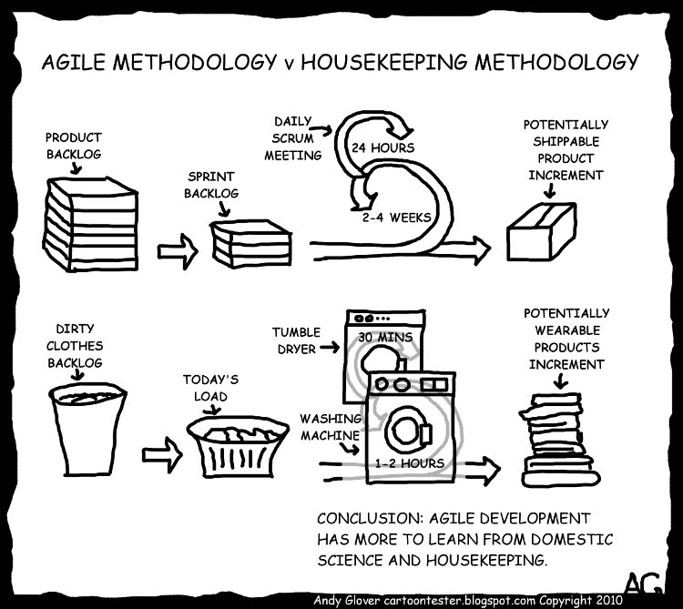
You are already Agile!

Slide 27
Scrum Team
The Development Team (3 to 9 people):
Self organizing (no sub-teams)
Self motivated
Optimize flexibility, creativity, and productivity
Have specialized skills and areas of focus but work together as a whole.
Common Goal
Scrum Master: (“Servant-Leader”) makes sure team stays on track & true to Scrum framework.
Product Owner: an Individual who owns the product backlog feeding the Scrum Team with requirements.
(Schwaber & Sutherland, 2013)

Slide 28
Kanban
“Visual signal” or “card” – Japanese
Toyota’s visual manufacturing process (steps)
Visual picture of work – Sticky notes on whiteboard
Visualize Work
See bottlenecks , empty spaces, queues – increase communication, act fast to reduce delays.
Limit Work in Progress
Greater focus, reduced need to prioritize
Focus on Flow
Continues Improvement
(of process)
Tracking flow, quality of process
https://leankit.com/learn/kanban/what-is-kanban/

Slide 29
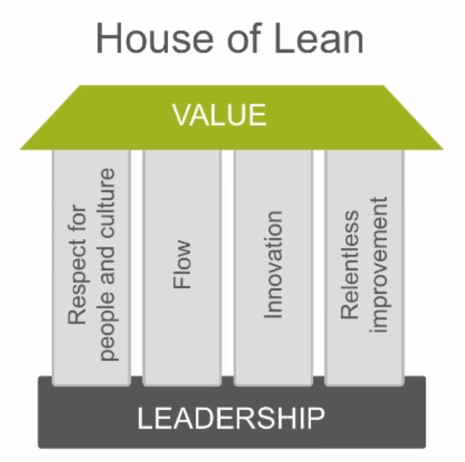
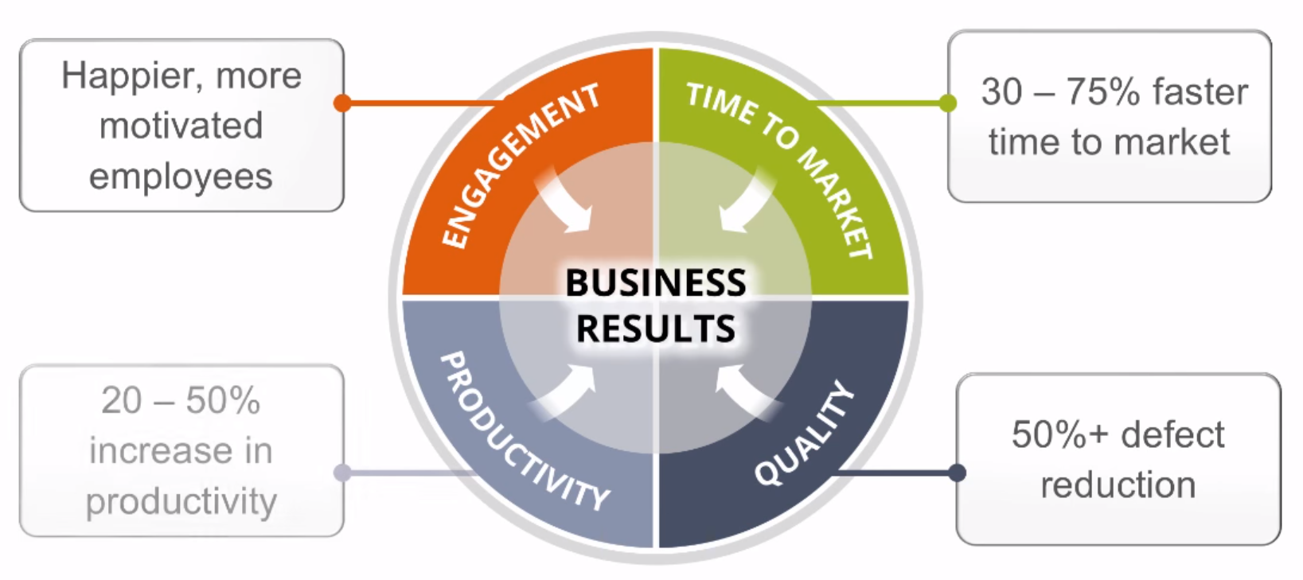
Scaled Agile Framework (SAFe)
How do we scale Agile to enterprise- Team of Teams?
Lean Agile Mindset
Focus on delivering value (software) quickly – more value over a single release (waterfall)
Use Agile Manifesto Principals
http://www.scaledagileframework.com/

Slide 30
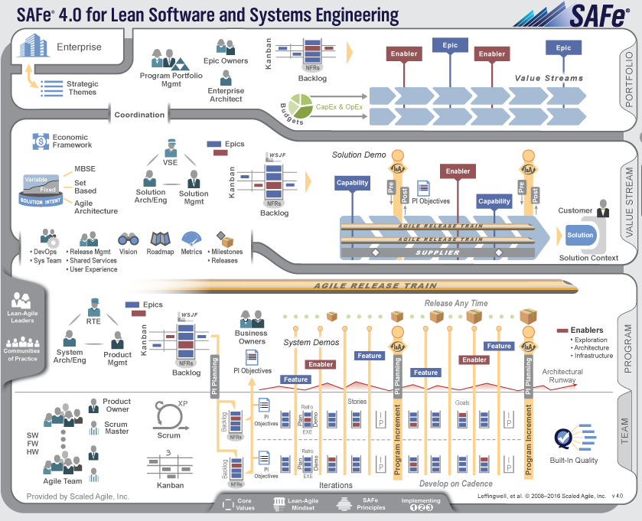
http://www.scaledagileframework.com/

Slide 31
Scaled Agile Framework (SAFe)
Additional Resources
https://www.scaledagileframework.com/videos-and-presentations/ Short Videos Introducing SAFe
https://www.scaledagile.com/resources/safe-whitepaper/
- White Paper explaining the process
http://www.scaledagileframework.com/safe-lean-agile-principles/ Overview of SAFe Principals
Case studies: http://www.scaledagileframework.com/case-studies/
http://www.scaledagileframework.com/

Slide 32
Selecting a Process
Consider the characteristics of the project:
Are requirements well known?
Will the system need to be flexible for future changes?
How is the team constructed?
Distributed/Local/Offshore
Developer knowledge
Constraints of when the system should be delivered?

Slide 33
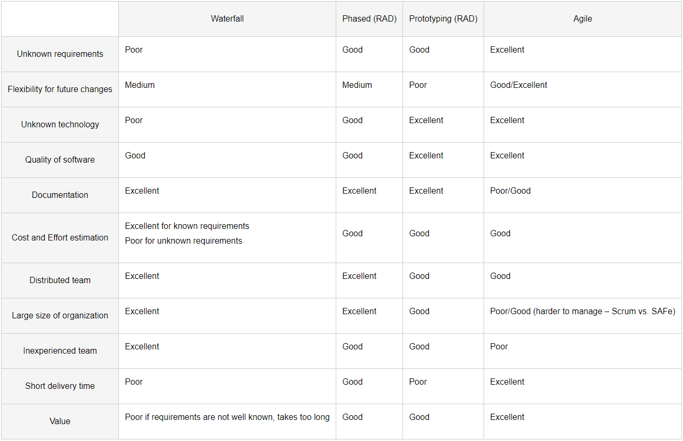
Selecting Methodology

Slide 34
Risk Management

Slide 35
Risk Assessment
The process of identifying, evaluating, and controlling what might go wrong in a project before it becomes a threat to the successful completion of the project or implementation of the information system. (Whitten, 2007)
When issues come up that could potentially have an impact on the success of a project, they are referred to as risks.
A risk is something that may happen, it is not something that has already happened.
Since the project is on a very tight deadline there is a possibility of it not finishing on time, costing developer delay penalty and reputation.
The biggest risks are often those that we are not even aware of- effort is required to deliberately seek risks.

Slide 36
Risk Management Activities
Identify risks by imagining worst-case scenarios.
This is the hardest part!
Likelihood of occurring, cost of impact, cost of managing.
Categorize risk (Organizational or Technical)
Prioritize identified risks to enable focus on those most serious.
The first step may yield too many risks given the time for completion of the project.
Develop a Mitigation Plan to deal with each risk.
Choose to take it on ("conquest") or avoid it..
Consider Residual Risk

Slide 37
Considering Issues for Risks
We start by thinking of issues within our project.
Issues are not yet clearly defined risks!
Possible issues in an IT Project:
Project is on a tight deadline.
Project has a single developer, several are needed.

Slide 38
Risk Issue vs. clearly defined Risk
Identify most clearly defined risk on purchasing milk.
Purchasing expired milk.
Issue
Purchasing expired milk leads to food poisoning.
Issue and Impact
By not reviewing the expiration date on the milk carton could result in purchasing expired milk, which in turn could result in food poisoning.
Clearly defined Issue and Impact

Slide 39
Categorizing Risks
Organizational Risks: result of people’s actions—what they do and don't do—and the way they are organized.
Technical Risks: result from technical issues—potential difficulties caused by specific hardware and software problems.
Organizational Examples:
Since the project is on a very tight deadline with less than needed number of developers there is a possibility of it not finishing on time resulting in additional costs and loss of future business.
Development team does not have enough experienced developers which may result in the project deliverable being lower in quality.
Technical Risk Examples:
Since application requires backwards compatibility with flash, this may result in limitations of platforms which can be used.

Slide 40
Prioritizing Risks
No. | Title | Estimated likelihood of occurring (L: 1-10 with 1 lowest likelihood) | Estimated impact (I: 1-10 with 1 lowest impact) | Estimated cost of managing (M: 1-10 with 1 lowest cost) | Priority number (lowest number handled first) (11-L) *(11-I)*M
1 | Deadlines | 8 | 9 | 9 | 3*2*9=54
2 | Team Experience | 8 | 8 | 9 | 3*3*9=81
3 | Backwards compatibility | 4 | 7 | 4 | 7*4*4=112
Note: Reason why 11- Likelihood and 11-Imact is to show lower values represent higher urgency
Calculating Priority = (11 – Likelihood) * (11 – Impact) * cost of Managing

Slide 41
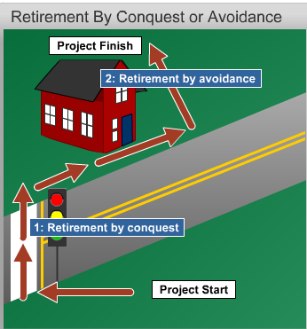
Risk Mitigation Strategy
Conquest: Face it head on and ensure that it cannot occur. Do this by addressing specific risk factors.
Avoidance: Seek an alternate course of action
Module 2 CS682: Strategies for Managing Risks

Slide 42
Mitigating Risk Examples
We can manage the “Backwards Compatibility” risk by avoidance:
Decide that quickMessage will not be compatible with Flash and code strictly for new and upcoming OS standards.
----------------------------------------------------------------------------------------We can manage the “Deadlines” risk by conquest:
Since the deadline is not movable, use timeboxing to insure most important features are completed with quality in mind, moving non-essential features to the next sprint. This will also help residual risk, keep pushing features to the next sprint.

Slide 43
Risk Credibility
Researching and Identifying Risks…
Is your risk real? This is where research comes in.
Turns out that purchasing expired milk at the store and getting food poisoning has low likelihood.
Most poisoning from drinking milk comes from drinking raw unpasteurized milk.
Make your risks realistic…
Likelihood, Cost of Impact, Cost of Managing
“Cases of Campylobacter, which can thrive in raw milk and poultry, grew by 14 percent over the last five years, a government study found.”
http://www.cbsnews.com/8301-204_162-57580471/food-poisoning-from-bacteria-found-in-raw-milk-poultry-and-shellfish-on-the-rise/

Slide 44
References
Braude, E. Polnar J (2018). Module 2 IT Systems & Introduction to Process. Metropolitan College, Boston University, Boston, MA.
Whitten, B. (2007). Systems analysis & design methods. (7th ed.). New York, NY: McGraw-Hill Irwin.
Dennis, A., Wixom, B. H., Tegarden, D. (02/2015). Systems Analysis and Design: An Object Oriented Approach with UML, 5th Edition
Manifesto for agile software development. (2001). Retrieved from http://agilemanifesto.org/
Defining refactoring. (n.d.). Retrieved from http://sourcemaking.com/refactoring/defining-refactoring
Schwaber, K., & Sutherland, J. (2013). The scrum guid. Scrum.org. Retrieved from https://www.scrum.org/Portals/0/Documents/Scrum Guides/2013/Scrum-Guide.pdf
Scrum (Collins English Dictionary) Retrieved from http://www.thefreedictionary.com/scrum
Scrum Alliance. (Designer). Scrum Explained [Web Graphic]. Retrieved from http://www.scrumalliance.org/why-scrum
Barrau, G. (Photographer). (2010, 05 30). A scrum is formed in the Final of the French Elite Championship in 2009. FCL v PIA [Web Photo].
What is Lean Retrieved from https://www.lean.org/WhatsLean/
Scaled Agile Framework (SAFe) Retrieved from http://www.scaledagileframework.com/
What is Kanban Retrieved from https://leankit.com/learn/kanban/what-is-kanban/

